Slide 1
KERNEL COMPILATION

Slide 2
CONTENTS
Overall view of kernel compilation.
Kernel modules.
Module utilities.
Adding our own driver to kernel image.
Cross tool chain
How to build binaries and modules using buildroot.

Slide 3
linux kernel
The Linux kernel is a free and open source , monolithic, modular, multitasking, Unix-like operating system kernel. It was originally authored in 1991 by Linus Torvalds for his i386-based PC, and it was soon adopted as the kernel for the GNU operating system, which was to be a free (libre) replacement for Unix.
Linux is provided under the GNU General Public License version 2 only, but it contains files under other compatible licenses. Since the late 1990s, it has been included as part of a large number of operating system distributions, many of which are commonly also called Linux.
Linux is deployed on a wide variety of computing systems, such as embedded devices, mobile devices (including its use in the Android operating system), personal computers, servers, mainframes, and supercomputers. It can be tailored for specific architectures and for several usage scenarios using a family of simple commands (that is, without the need of manually editing its source code before compilation)

Slide 4
Contd…
privileged users can also fine-tune kernel parameters at runtime. Most of the Linux kernel code is written using the GNU extensions of GCC to the standard C programming language and with the use of architecture-specific instructions (ISA) in limited parts of the kernel. This produces a highly optimized executable (vmlinux) with respect to utilization of memory space and task execution times.
Day-to-day development discussions take place on the Linux kernel mailing list (LKML). Changes are tracked using the version control system git, which was originally authored by Torvalds as a free software replacement for BitKeeper.
Linux kernel is the main core component of the system which requires libraries and application to provide feature

Slide 5
Features of linux kernel
Linux kernel is portable and it has huge hardware support because it run and support most of the architecture.
The linux can run of super computer as well as tiny devices this shows it scalability.
It is most secured and its code is reviewed by many experts.
It is more stable and reliable.
Linux kernel supports modularity. that is at run time we can load and unload the module a side.
It is easy to program we can learn from the existing code, because it is open source.
It has exhaustive networking support.
The kernel manages all the hardware resource like cpu , input/output device and memory devices.

Slide 6
System calls
The main interface between the kernel and user space is the set of system calls.
About 300+ system calls that provide the main kernel services:
File and device operations, networking operations, inter-process communication, process management, timer, thread, memory mapping, synchronization premetives etc.

Slide 7
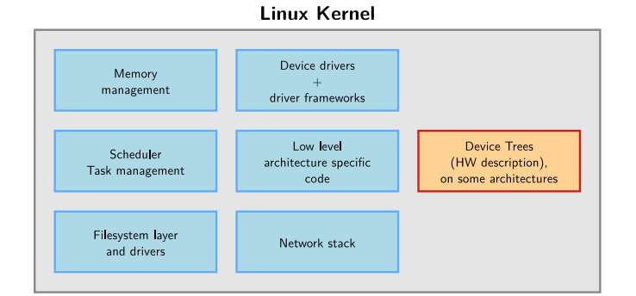
inside the Linux kernel

Slide 8
linux kernel source code
The mainline versions of the Linux kernel, as released by Torvalds These versions follow the development model of the kernel They may not contain the latest developments from a specific area yet A good pick for products development phase https://git.kernel.org/pub/scm/linux/kernel/git/torvalds/linux.git
The kernel sources are available from https://kernel.org/pub/linux/kernel as full tarballs (complete kernel sources) and patches (differences between two kernel versions).
But today the entire open source community has settled in favor of Git Fast, efficient with huge code bases, reliable, open source Incidentally written by Torvalds

Slide 9
Location of non-official kernel sources
Many chip vendors supply their own kernel sources
• Focusing on hardware support first • Can have a very important delta with mainline Linux • Sometimes they break support for other platforms/devices without caring
• Useful in early phases only when mainline hasn’t caught up yet (many vendors invest in the mainline kernel at the same time)
Many kernel sub-communities maintain their own kernel, with usually newer but fewer stable features, only for cutting-edge development
• Architecture communities (ARM, MIPS, PowerPC, etc)
• Device drivers communities (I2C, SPI, USB, PCI, network, etc) • Other communities (real-time, etc)

Slide 10
Going through Linux sources
Development tools:
• Any text editor will work
• Vim and Emacs support ctags and cscope and therefore can help with symbol lookup and auto-completion.
• It’s also possible to use more elaborate IDEs to develop kernel code, like Visual Studio Code.
Powerful web browsing:
Elixir Generic source indexing tool and code browser for C and C++.
• Very easy to find symbols declaration/implementation/usage Try out https://elixir.bootlin.com!

Slide 11
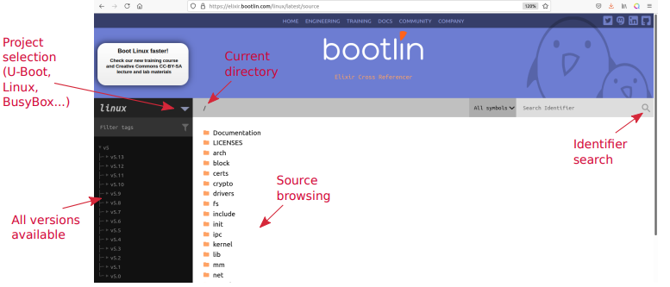
bootlin

Slide 12
Linux kernel sources structure
As of kernel version v5.18 (in percentage of total number of lines).
Source code:
▶ drivers/: 61.1%
▶ arch/: 11.6%
▶ fs/: 4.4%
▶ sound/: 4.1%
▶ tools/: 3.9%
▶ net/: 3.7%
▶ include/: 3.5%
▶ kernel/: 1.3%
▶ certs/:
0.0% Doc and bindings
▶ lib/: 0.7%
▶ usr/: 0.6%
▶ mm/: 0.5%
▶ scripts/: 0.4%
▶ security/: 0.3%
▶ crypto/: 0.3%
▶ block/: 0.2%
▶ samples/: 0.1%
▶ ipc/: 0.0%
▶ virt/: 0.0%
▶ init/: 0.0%
▶ certs/: 0.0% Doc and bindings:
▶ Documentation/:
3.4% Build system files:
▶ Kbuild
▶ Kconfig
▶ Makefile Other files:
▶ COPYING
▶ CREDITS
▶ MAINTAINERS
▶ README

Slide 13
Contd…
/usr/src ->kernel header files.
Linux kernel headers are different from user level applications header files.
The entire linux kernel source code is written in ‘c’ lang. A little bit assembly language is used for cpu and machine initialization and exceptions and for critical library routine.
No “c++” is used.
To compile this kernel source code we cannot use online ANSI C compilers.
So,we have to download separate tool chain for the target boards.
In kernel source code no c library is used.that means we cannot use user level c library functions in kernel code.
In kernel source code every directory contains one Make file and kconfig file.
Linux kernel source code is designed to be portable that means the same source is used for different architectures.
Kernel will have its own set of kernel functions similar to user level c library functions

Slide 14
Kernel memory constraints
No memory protection
The kernel doesn’t try to recover from attemps to access illegal memory locations. It just dumps oops messages on the system console.
Fixed size stack (8 or 4 KB). Unlike in user space, no mechanism was implemented to make it grow. Don’t use recursion!
Swapping is not implemented for kernel memory either (except tmpfs which lives completely in the page cache and on swap)

Slide 15
Linux kernel licensing
The Linux kernel is licensed under the GNU General Public License version 2
• This license gives you the right to use, study, modify and share the software freely
However, when the software is redistributed, either modified or unmodified, the GPL requires that you redistribute the software under the same license, with the source code
• If modifications are made to the Linux kernel (for example to adapt it to your hardware), it is a derivative work of the kernel, and therefore must be released under GPLv2.
The GPL license has been successfully enforced in courts: https://en.wikipedia.org/wiki/Gpl-violations.org#Notable_victories
However, you’re only required to do so
→ At the time the device starts to be distributed
→ To your customers, not to the entire world

Slide 16
Proprietary code and the kernel
It is illegal to distribute a binary kernel that includes statically compiled proprietary drivers
The kernel modules are a gray area: unclear if they are legal or not
• The general opinion of the kernel community is that proprietary modules are bad: process/kernel-driver-statement
• From a legal point of view, each driver is probably a different case:
Are they derived works of the kernel?
Are they designed to be used with another operating system?
Is it really useful to keep drivers secret anyway?

Slide 17
Advantages of GPL drivers
You don’t have to write your driver from scratch.
You can reuse code from similar free software drivers.
Your drivers can be freely and easily shipped by others (for example by Linux distributions or embedded Linux build systems).
Legal certainty, you are sure that a GPL driver is fine from a legal point of view.

Slide 18
Advantages of mainlining your kernel drivers
The community, reviewers and maintainers will review your code before accepting it, offering you the opportunity to enhance it and understand better the internal APIs.
Once accepted, you will get cost-free bug and security fixes, support for new features, and general improvements.
Your work will automatically follow the API changes.
Accessing your code will be much easier for users.
Your code will remain valid no matter the kernel version. This will for sure reduce your maintenance and support work

Slide 19
User space device drivers
Advantages
No need for kernel coding skills.
Drivers can be written in any language, even Perl!
Drivers can be kept proprietary.
Driver code can be killed and debugged. Cannot crash the kernel.
Can use floating-point computation. Potentially higher performance, especially for memory-mapped devices, thanks to the avoidance of system calls.
Drawbacks
The kernel has no longer access to the device. • None of the standard applications will be able to use it.
Cannot use any hardware abstraction or software helpers from the kernel • Need to adapt applications when changing the hardware.
Less straightforward to handle interrupts: increased latency.

Slide 20
Kernel configuration
The kernel contains thousands of device drivers, filesystem drivers, network protocols and other configurable items
Thousands of options are available, that are used to selectively compile parts of the kernel source code
The kernel configuration is the process of defining the set of options with which you want your kernel to be compiled
The set of options depends
On the target architecture and on your hardware (for device drivers, etc.)
On the capabilities you would like to give to your kernel (network capabilities, filesystems, real-time, etc.). Such generic options are available in all architectures.

Slide 21
Kernel configuration and build system
The kernel configuration and build system is based on multiple Makefiles
One only interacts with the main Makefile, present at the top directory of the kernel source tree Interaction takes place
using the make tool, which parses the Makefile
through various targets, defining which action should be done (configuration, compilation, installation, etc.).
Run make help to see all available targets.
Example
cd linux/
make <target>

Slide 22
Kbuild , Kconfig
In the Linux kernel build system, a Kbuild file (usually named "Kconfig" or "Makefile") is a configuration file that specifies how the kernel should be compiled. Kbuild files are used to define kernel configuration options, build targets, and dependencies between files.
The Kconfig file is used to define kernel configuration options, which allows developers to select the features and components that should be included in the kernel. These options are displayed to users during the configuration process, and users can select which options they want to include or exclude from the kernel.
Kbuild files are essential to the Linux kernel build process, as they provide a way to customize the kernel build based on the target platform, hardware features, and user preferences.

Slide 23
Makefile
The Makefile is used to define build targets and dependencies between files. It specifies which source files should be compiled, how they should be compiled, and which object files should be linked together to create the final kernel image.
TYPES OF MAKEFILES :-
HEADERS: myheader. h
OBJ:1.o 2.o 3.o
cc=gcc
CFLAG= -c
a.out:$(OBJ)
$(cc) $(OBJ)
1.o:1.c $(HEADERS)
$(cc) $(CFLAG) 1.c $(HEADERS)
2.o:2.c $(HEADERS)
$(cc) $(CFLAG) 2.c $(HEADERS)
3.o:3.c $(HEADERS)
$(cc) $(CFLAG) 3.c $(HEADERS)
HEADERS=myheader. h
OBJ=1.o 2.o 3.o → $(wildcard *.o)
SRC=1.c 2.c 3.c → $(wildcard *.c)
cc=gcc
CFLAGS= -c
all: objs a.out
Objs:$(SRC)
$(cc) $(FLAGS) $(SRC) $(HEADERS)
a.out:$(OBJ)
$(cc) $(OBJS)

Slide 24
Kernel modules:
make mrproper
make distclean
make menuconfig
make
make modules
make install
make modules_install

Slide 25
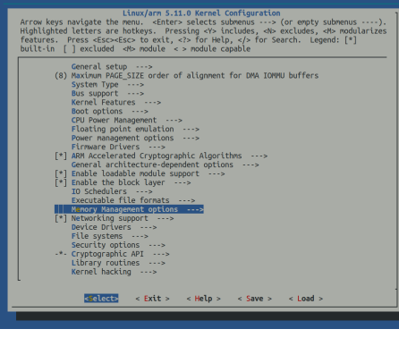
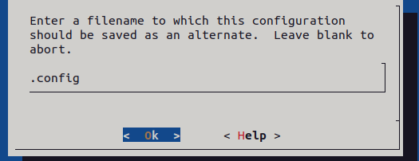
Make menuconfig
$ sudo make menuconfig
Using above command It will generate .config file
*->y , M->module , Space->notset

Slide 26
This kernel image is a single executable binary file. So it is generated by linking multiple object files corresponds to the futures enabled in the configuration.
The kernel options can be selected during the make menuconfig as part of kernel image or separate image can be ignored.
For this we have different types of options
Bool options
Tristate
For make menuconfig, it requires lib ncurses –dev packages.
$ sudo apt install libncurses –dev.

Slide 27
Make
This generates vmlinux the raw uncompressed kernel image which is in elf format useful for debugging . But cannot be booted.
The final compressed kernel image that can be booted is generated in /arch/architecture name/boot/image name.
For x-86 architecture we can see bz image and z image for arm architecture.
$ sudo make

Slide 28
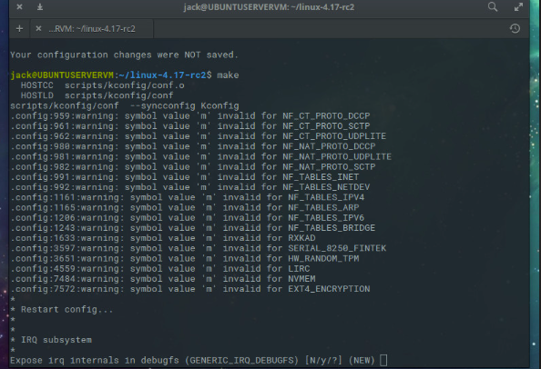

Slide 29
Make modules:
This will generate all .ko files
.c files->.o->.ko
The options which are selected with ‘M’ that can be converted in to .ko file.
$ sudo make modules

Slide 30
Make modules_install:
It must be run as a root user. It does the installation for host system by default.
It installs the modules that are generated or copied to /lib/module/kernel version/directory.
It will generate modules. alias, modules. Alias .bin are used for modules loading.
And modules .symbols, modules .symbols .bin are used for module symbols.
And modules .deb , modules .deb .bin for module dependencies.
$ sudo make modules_install

Slide 31
Make install:
It does the installation for host system by default. So it must be run as a root user
$ sudo make install
It installs the generated kernel image Vmlinuz copies to /boot/Vmlinuz –kernel version. From arch/architecture name/boot directory and along with system .map and .config file.
MAKE CLEAN:
To clean up the generated files we have to use
$ sudo make clean

Slide 32
ABOUT KERNEL MODULES
In any operating system kernel is the main core component of the system.
Kernel is the place where we’ve store the most important function and everything that’s why call it as heart of the Operating system.
Selection of kernel code that can be compiled ,loaded, and unloaded independent of the rest of the kernel.
A kernel module may typically implement a device driver, a file system ,or a networking protocol.
The module interface allows third parties to write and distribute on their own terms, device drivers or file systems that could not be distribute under the GPL.
Kernel modules allow a Linux system to be set up with a standard ,minimum kernel, without any extra device drivers built in.

Slide 33
KERNEL MODULES(CONT..)
The modules are useful to keep kernel image size should be minimum and reduces the boot time.
The modules can be loaded as a root user.
When a module is loaded the related information is available in the kernel log.
The kernel keeps its messages in a circular buffer.
We can see the kernel logs by using command =>$ sudo dmesg
The default log level is 5(five).so, dmesg is extract kernel logs by specific file path is
/varlog/syslog
The kernel module is different from user level applications we can see this module with.ko extension i.e. kernel object
Each module will’ve one initialization function() and clean_up() or exit().these function names are defined by the user.

Slide 34
KERNEL MODULES(CONT..)
While loading the module the initialization function () gets executed and how the modu;le is ready to receive the request comming from application or Hardware.
When function loaded Initialization function() symbols are added to the kernel symbol table by dynamically. =>/proc/kallsyms
And the definations are added to .text segment of loaded kernel image, each kernel module function is applied with static keyword
When you unload the module cleanup/exit() gets executed.
The corresponding entry’s are deleted and definations are removed from kernel image(.text)
Removed symbols info from /proc/kallsyms
Entry’s are deleted from /proc/devices or /proc/modules
While loading and unloading the prints comming from these function are redirect to kernel logs.
For every module we write separate makefile, If a kernel function is not receiving any inputs, we must specify it as void
In the driver code we’ve to use two kernel macros at the end of driver code to specify initialization() and exit()

Slide 35
module init() and exit()
Example:
#include<linux/init.h>
#include<linux/module.h>
Static int hello_module(void) //initialization()
{ pr_info(“My module loaded Done!!\n”);
return 0;
}
static void hello_exit_module(void) //exit()
{ pr_info(“My module unloaded\n”);
}
module_init(hello_module);//fun() base addr
module_exit(hello_exit_module);//fun() base addr
Example:
#include<linux/init.h>
#include<linux/kernel.h>
#include<linux/module.h>
int __init init_module(void) //initialization()
{
printk(“<1>” “My module loaded Done\n”);
return 0;
} void __exit cleanup_module(void) //cleanup()
{
printk(“<1>” “My module unloaded\n”);
}

Slide 36
IMPORTANCE OF KERNEL MODULES
Why need kernel moules?
Kernel modules are pieces of code that can be loaded and unloaded into the kernel upon demand.
They extend the functionality of kernel without the need to reboot the system.
A module can be configured as built-in 0r loadable.
Modularized code runs in kernel space.
Usually a driver performs both tasks outlined previously.
Some modules are executed as part of system calls and some are in charge of interrupt handling.
Interrupt Handler:
Once , the handler return ,the CPU resumes what it was doing before the interrupt occurred.
The DDI/DKI provides interfaces for registering and servicing interrupts.

Slide 37
COMPONENTS OF KERNEL
Three components to Linux module support are
1.Module Management: Supports loading into memory and letting them talk to the rest of the kernel.
Module loading is spiliting into two separate sections
→Manging sections of module code in kernel memory.
Whenever the process came the sections are formed.
→Handling symbols that modules are allowed to reference.
Only if module is in use only then it is loaded else unloaded.
Module requestor manages loading requested, but currently unloaded, modules, it also regularly queries the kernel to see whether a dynamically loaded module is still in use, and will unload it when it is no longer actively needed.

Slide 38
2.Driver Registration:
Allows modules to tell the rest of the kernel that a new driver has become available.
The Kernel maintains dynamic tables of all known drivers, and provides a set of routines to allow drivers to be added to or removed from these tables at time.
Registration tables include the following items:
Device drivers
File systems
Network protocols
Binary format

Slide 39
3.Conflict Resolution
A mechanism that allows different device drivers to reserve hardware resources and to protect those resources from accidental use by another driver.
The conflict resolution module aims to:
Prevent modules from clashing over access to hardware resources.
Prevent autoprobes(Device driver probes) from interfering with existing device drivers.
Resolve conflicts with multiple drivers trying to access the same hardware.
Eg: like kernel fighting with the single thread at the same time.

Slide 40
The dmesg commands is used to write the kernel messages in linux and other Unix-like operating systems to standard output.
dmesg obtained its data by reading the kernel ring buffer. A buffer is a portion of a computers memory that is set aside as a temporary holding place for data that is being sent to or received from an externel device, such as a hard disk(HDD),printer or keyboard.
A ring buffer is a buffer of fixed size for which any new data added to it overwrites the oldest data in it.
ABOUT DMESG

Slide 41
ABOUT PRINTK()
The kernel print function ,printk(),behaves almost identically to the C library printf() function.
Printk() is simply the name of the kernel’s formatted print function. It is callable from just about anywhere in the kernel at any time.
The major difference b/w printk() and printf() is the capabilityu of the former to specify a loglevel.
The kernel uses the logleves to decide whether to print the message to the console .The kernel displays all messages with a loglevel below a specified value on the console.
printk() Examples:
printk(KERN_WARNING “This is Warning\n”);
printk(KERN_DEBUG “This is a debug notice!!\n”);
printk(“I did not specify a log level!!\n”);

Slide 42
MODULE COMMANDS
lsmod
List all loaded modules.
insmod
Install a specific module
modprobe
Loads a module and any dependency.
rmmod
Remove a module
We can go to the cd /lib/modules/ directory
To check the current Kernel versions in that we can go to the particular driver to check the device files and so on.
We can see list of drivers then go and check the device files in that.

Slide 43
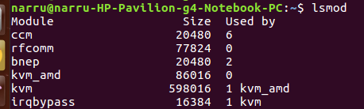
lsmod
.lsmod is a command on Linux systems.
.It shows which loadable kernel modules are currently loaded.

Slide 44
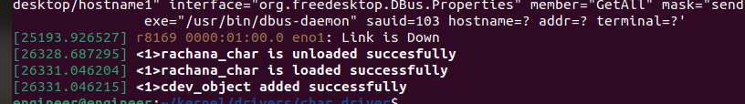
insmod
insmod command is used to insert modules into the kernel.
This command inserts the kernel object file (.ko) into the kernel.
Syntax:
-insmod <module_name>.ko

Slide 45
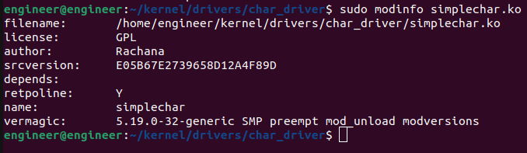
Modinfo
modinfo command is used to display the information about a linux kernel module.

Slide 46
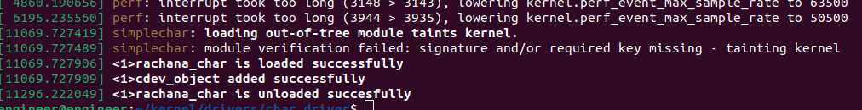
rmmod
rmmod command is used to remove a module from the kernel.
Most of the users use modeprobe with the –r option instead of using rmmod.
Syntax:
-rmmod <module_name>.ko

Slide 47
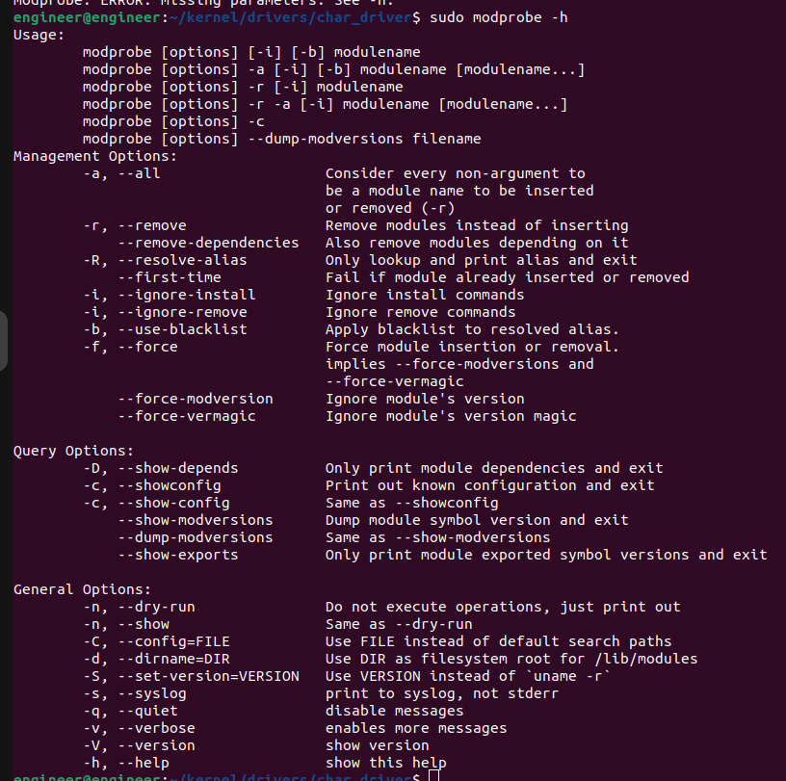
modprobe
modprobe command will add or remove modules on linux.
The kernel uses modprobe to request modules.
The modprobe command searches through the standard installed module directories to find the necessary drivers.

Slide 48
How to add a module into kernel source code
Firstly open the linux source code in that go to the drivers folder.
In that driver folder create a folder for your driver , I’m considering as “mydriver”.
In that folder copy your driver code and create a kconfig file and makefile for your driver.
Now update the entry of your driver in the kconfig file and Makefile of the /driver folder.
After updating everything now run make menuconfig and after that make.

Slide 49
Obj -$(CONFIG_MY_CHARDEV)+=driver.o
/driver
driver.c
makefile
Source “driver/mychar1/Kconfig”
mychar1
Kconfig
Config mychar1
Tristate
Help
Say -y
Kconfig
makefile
Obj -$(CONFIG_MYCHAR1)+=mycahr1/

Slide 50
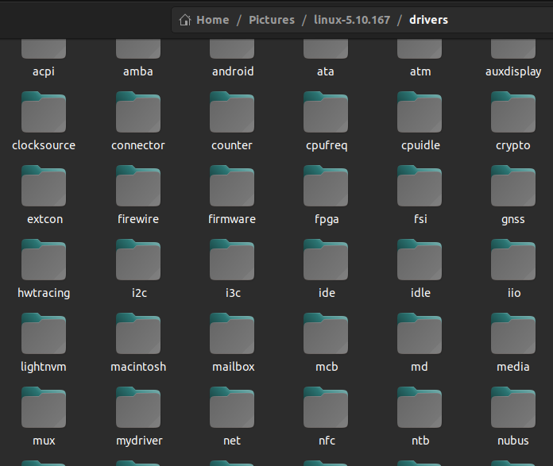
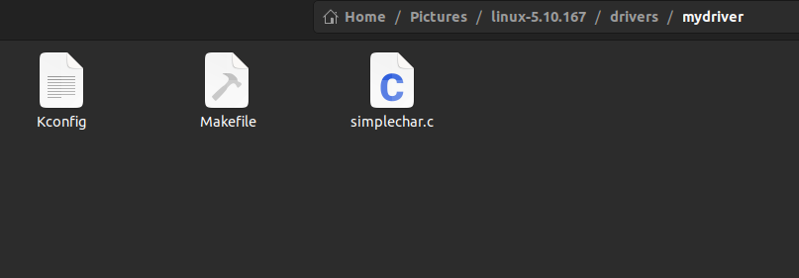

Slide 51
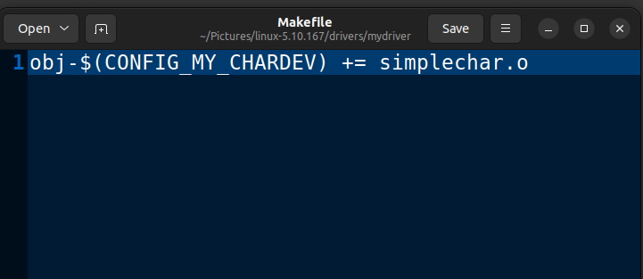
Make file
Obj-$(CONFIG_MY_CHARDEV) += simplechar.o

Slide 52
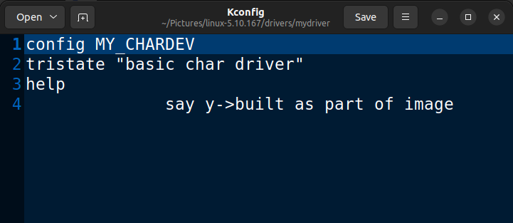
Kconfig
Config MY_CHARDEV
tristate “basic char driver”
help
say y->built as part of image

Slide 53
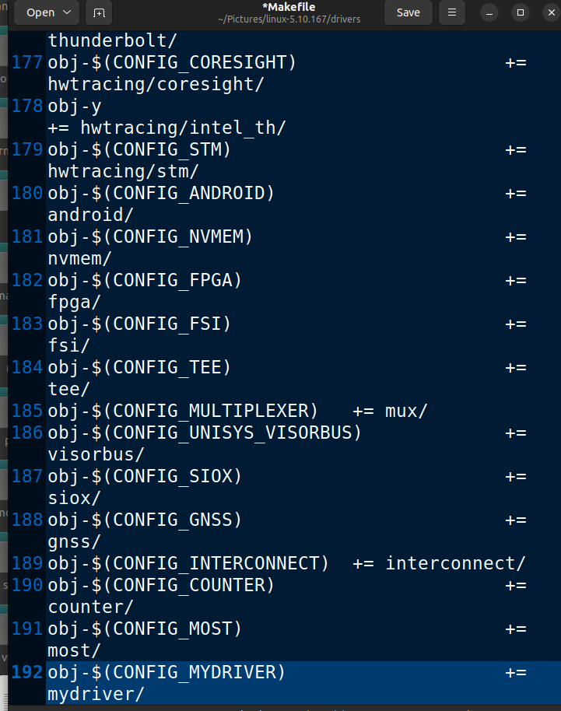
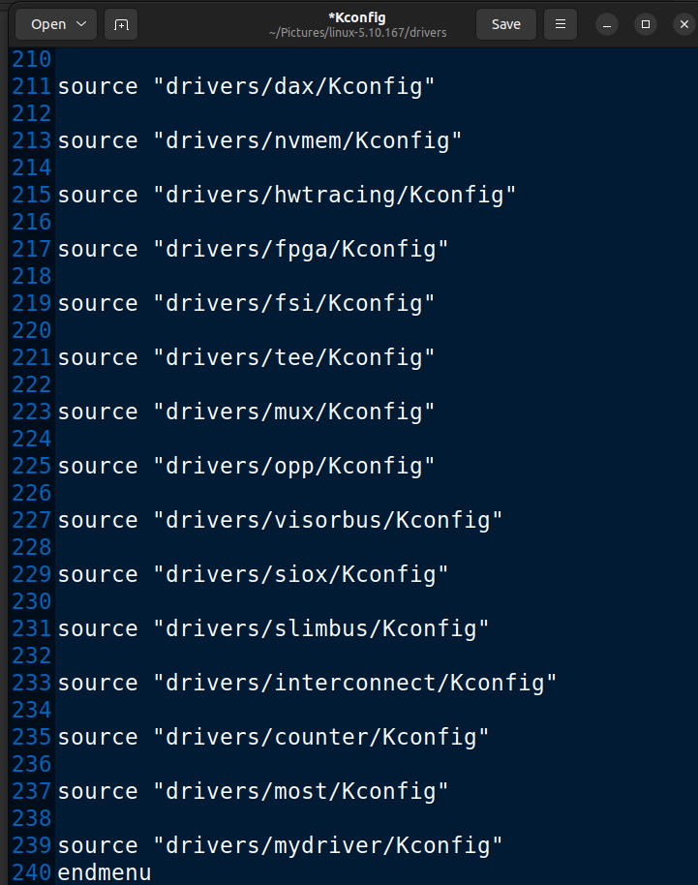
Updating in the driver folder
MAKEFILE :- KCONFIG :-

Slide 54
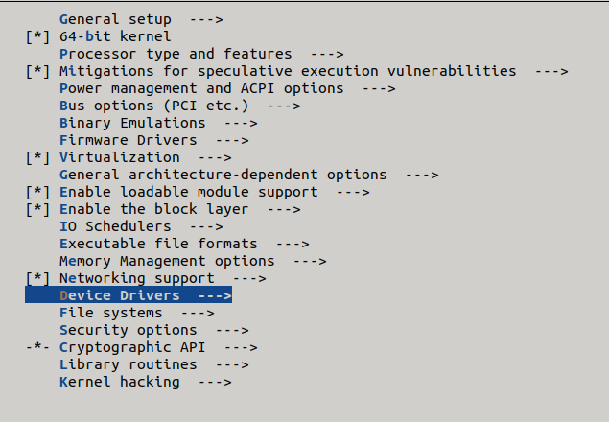
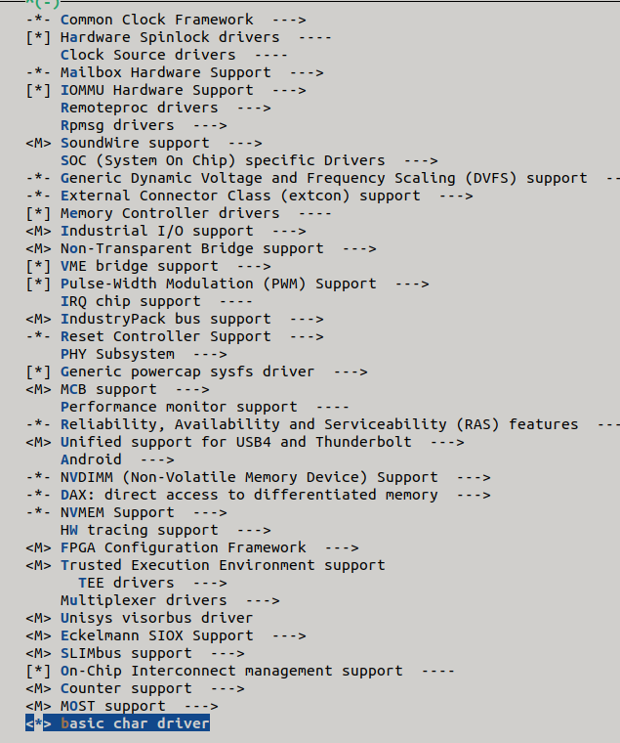
Make menuconfig

Slide 55
Options
*----------------------y
‘*’ →means loading the driver or module as part of kernel image
m---------------------m
‘M’→ means loading the driver as module so that you can load at runtime into the kernel image
Space--------------- “ ”
“ “→means driver is not a part of kernel compilation which can be ignored

Slide 56
Cmd1 : $make menuconfig
When we run make menuconfig command it will list out all kernel modules which are present in kconfig file in every directory it shows as terminal interface
Cmd2 : $make
When make command executed it will generate .ko which are mentioned as ‘*’ in make menucofig
Cmd3 : $sudo make modules
When make modules command executed it will generate .ko which are mentioned as ‘M’ in make menucofig
Cmd4 : $sudo make modules_install
When make modules_install command executed it will install the modules which are mentioned as ‘M’ in make menucofig
Cmd5 : $sudo make install
When make install command executed it will generate kernel bzimage.
After that update the grub And reboot the system
Now the os is updated with our new kernel module as part of our kernel image.

Slide 57
What is compiler?
Compilers are the tool used to translate high-level programming language to low-level programming language.
Simply converting the source program into machine code.
Ex : turboC or GCC
The simple compiler works in one system only, but what will happen if we need a compiler that can compile code from another platform, to perform such compilation.
So cross compiler is introduced.

Slide 58
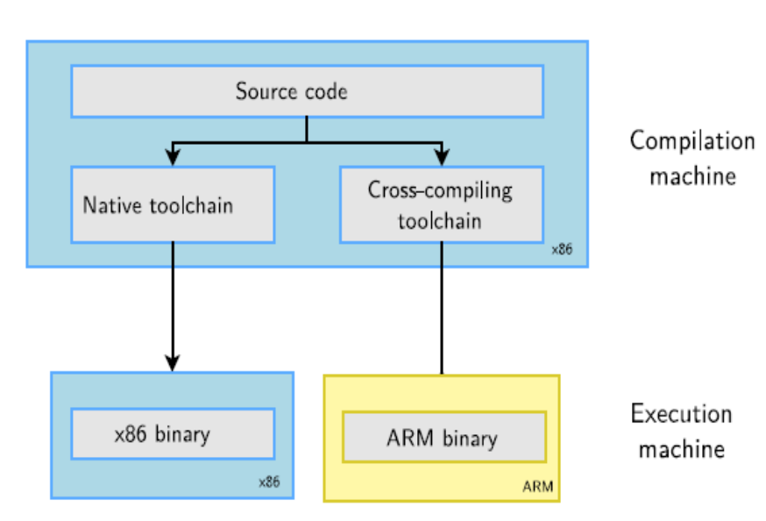
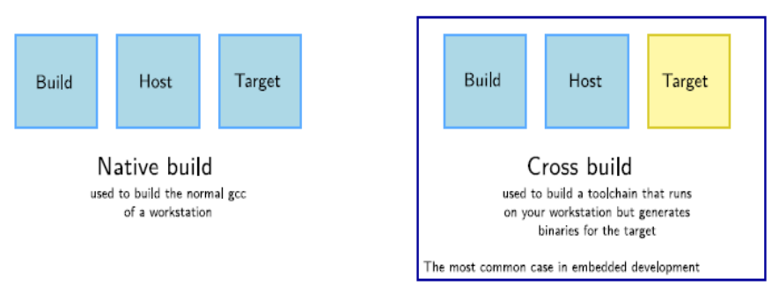
Native Compiler : Native compiler are compilers that generates code for the same Platform on which it runs. It converts high language into computer’s native language. For example Turbo C or GCC compiler
Cross compiler : A Cross compiler is a compiler that generates executable code for a platform other than one on which the compiler is running. For example a compiler that running on Linux/x86 box is building a program which will run on a separate Arduino/ARM.

Slide 59
What is Cross compiler?
Cross compiler is also know as retargetable compiler.
The process of creating executable code for a different machine is also called retargeting.
For example, a cross compiler executes on machine X and produces machine code for machine Y.
Keil is a cross compiler.
Cross tool chain set up
It can be done by 3 ways
We can export the path
$export ARCH=<architecture> //ARCH=arm
$export CROSS_COMPILE=<path> //path=path of the tool chain(target board)
This will update the environmental variables of current working directory and now you can directly generate the binaries for target board.
The other way is to directly give the architecture name and the cross-compiler path as shown below:
$make ARCH=arm CROSS-COMPILE=<path of the cross-compiler>

Slide 60
The other way is that we can directly update the path in the .bashrc which will be set permanently.
to set the path permanently follow below steps:
Go to .bashrc file [vim .bashrc]
Now go to the end of the file and enter the path of the toolchain as shown below
Export PATH=“<path of the toolchain:$PATH”
Exit from the .bashrc by saving the modifications.
Now sink the modifications made by using below command.
$source .bashrc
5.Now we can access the tool chain from any directory in the terminal.
We can also install the toolchain by using the commands
$sudo apt-get install gcc-arm-linux-gnueabi
$sudo apt-get install gcc-arm-linux-gnueabihf

Slide 61
Building Kernel for Target board(raspberry pi):
Firstly download the source code by using
git clone --depth=1 https://github.com/raspberrypi/linux
or
download the required version of the source code from
https://github.com/raspberrypi/linux
Now select the board for which you want to develop the kernel image by using
for 64-bit
make ARCH=arm64 CROSS_COMPILE=aarch64-linux-gnueabihf-
for 64-bit
make ARCH=arm64 CROSS_COMPILE=aarch64-linux-gnueabihf- zImage modules dtbs
This command will generate the image and requried dtbs files.

Slide 62
Installing on the sd-card
First, use lsblk before and after plugging in your SD card to identify it. You should end up with something a lot like this:
sdb
sdb1
sdb2
with sdb1 being the FAT filesystem (boot) partition, and sdb2 being the ext4 filesystem (root) partition.
Mount these first, adjusting the partition letter as necessary:
$mkdir mnt mkdir mnt/fat32
$mkdir mnt/ext4
$sudo mount /dev/sdb1 mnt/fat32
$sudo mount /dev/sdb2 mnt/ext4
NOTE: If you are unable to make the partition through commands then make the partion manually and directly try to copy remaining files.
Next, install the kernel modules onto the SD card:

Slide 63
for 64-bit:
$sudo env PATH=$PATH make ARCH=arm64 CROSS_COMPILE=aarch64-linux-gnueabihf- INSTALL_MOD_PATH=mnt/ext4 modules_install
Finally, copy the kernel and Device Tree blobs onto the SD card, making sure to back up your old kernel
for 64-bit:
$sudo cp arch/arm/boot/Image mnt/fat32/$KERNEL.img
$sudo cp arch/arm/boot/dts/*.dtb mnt/fat32/
$sudo cp arch/arm/boot/dts/overlays/*.dtb* mnt/fat32/overlays/
$sudo cp arch/arm/boot/dts/overlays/README mnt/fat32/overlays/
NOTE: The process is same for all the remaining board

Slide 64
Building Kernel image using buildroot
Download buildroot from vendors website or bulidroot.org.
Extract the zip file.
Go to config folder , in that select the board configuration.
Now generate the .config file for the target board , for that use below commands
$make <board name>
If you want to add any extra modules use below command and make the changes as per your requirement.
$make menuconfig
Now run make command , this will generate sdcard.img , tool chains , kernel headers and other required packages.

Slide 65
Now you have to dump the sdcard.img into your target board.
Now you have to generate the binaries of the files which you want to run on the target board.
For generating the binaries use above cross chain set up methods.
Now copy the binaries into any external file like pen drive and insert it to the target board.
Initially the external device will not be mounted , so u have to mount to for that use below command
$mount /dev/sda1 /media
Till now we have gone through with series of steps like generating the kernel image for a target board , sd image using build root , binaries and so on.
Meanwhile lets go forward with the workspace
If your board has HDMI support use connect a monitor to your target board directly .
Or else there are some essential tools.
An essential tool for the embedded development for serial line communation like hyper terminal in windows.
They are multiple option available in linux: minicom , putty , picocom etc.
You download them form third party vendors website or you can use the command
$sudo apt install minicom

Slide 66
References:
https://bootlin.com/docs/
https://embetronicx.com/
https://buildroot.org/
Armporting

